Slide 1
Predicting Hazardous Seas
Reni Faust
Notes:
This project is the final project for my Master’s of Data Science degree. We were given the opportunity to pick anything of interest we wanted to work on. I chose this topic after speaking with UNCW professor Gene Felice. He specializes in visualizations, however due to time constraints and conflicting schedules I realised I would need to find a better targeted project within the data we discussed.

Slide 2
Can Buoy Data Successfully Predict Unsafe Ocean Conditions?
Buoys measure various ocean attributes
Salinity
Conductivity
Turbidity
Tides
Winds
Depth
pH level
Dissolved Oxygen
And more
Notes:
Data was obtained from UNCW, and NOAA. The data from these locations was ideal because it was local enough to be relevant to the target audience, messy enough to mirror real world data, and extensive enough to train models on.

Slide 3
Sea Hazards
Hurricanes
Rogue waves
Dangerous storms
Acidification
Other threats
Notes:
Research was performed in hopes of finding an important real-world issue that could benefit from the work of an aspiring data scientist. It was found that one concern with ocean data was the ability to predict oncoming sea hazards.

Slide 4
Challenges
Unfamiliarity with data and its meaning
No clear or proposed method to achieve my goal
Data is inconsistent
Buoy failures
Different measurements are taken from different locations
Faulty readings
Uncertain how to distinguish between actual readings and false ones
Notes:
None of the buoys seem to take the same readings as its neighbours. In addition buoy failure appears to be fairly common-place. Research into the deeper meaning behind the data proved unfruitful.

Slide 5
Approach
Hurricane Data
Provides a verified example of a common hazard
Readings my provide insights
Data is easy to obtain
Filtering
Storm data pulled from NOAA
200552 records
Latitude and Longitude Pulled
Dates used to match data
Final Data 57,820 rows, 30 columns
Notes:
Rogue wave prediction was interesting but understanding what to look for proved to be a challenging issue. After careful thought and consideration about the data, it became apparent that there may be some similarities with several hazards and sea conditions during hurricanes. A decision was made to see how successfully models could predict hurricanes and then use this information to find out what predictors were important.

Slide 6
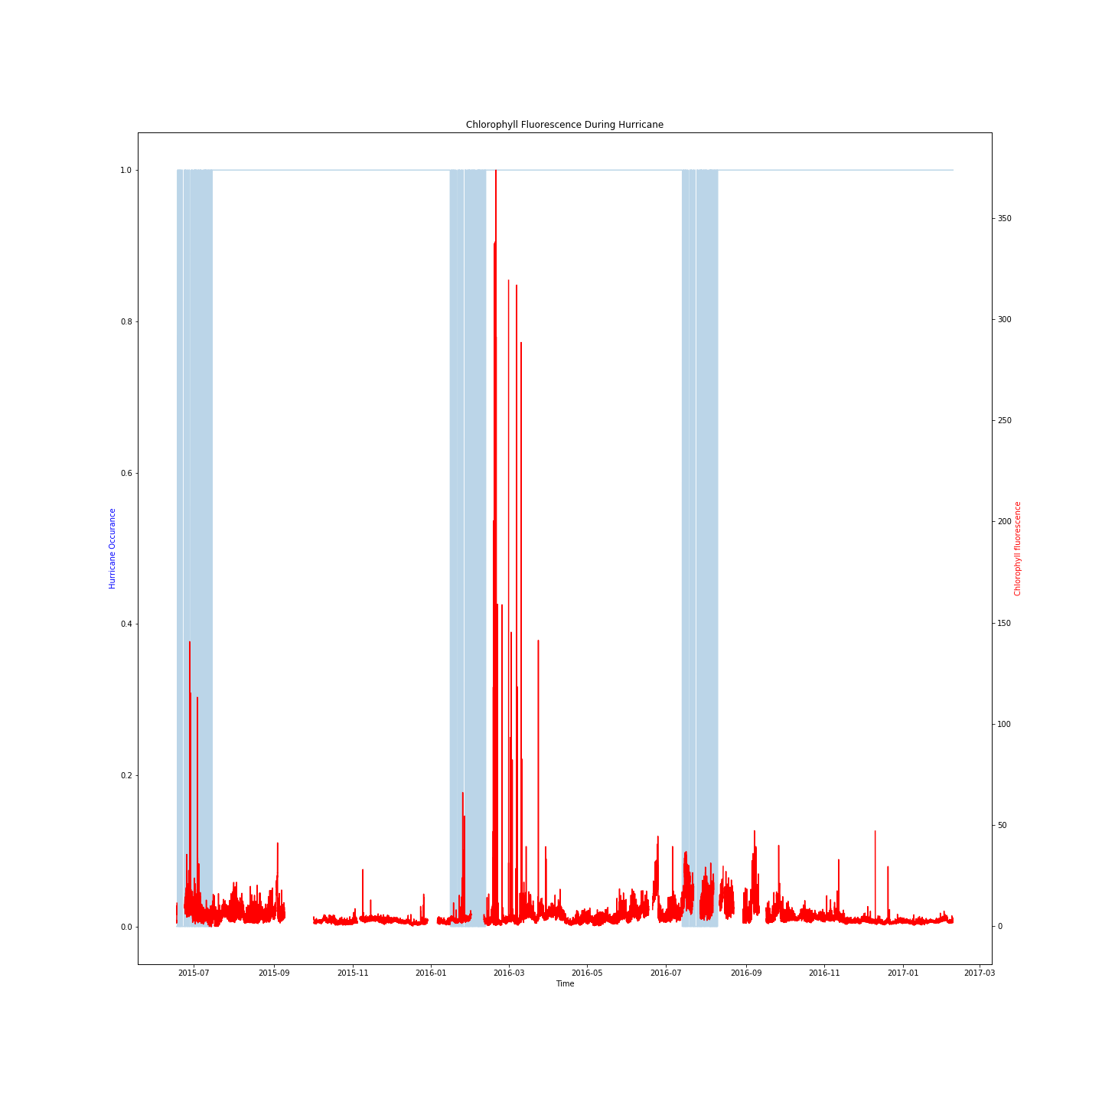
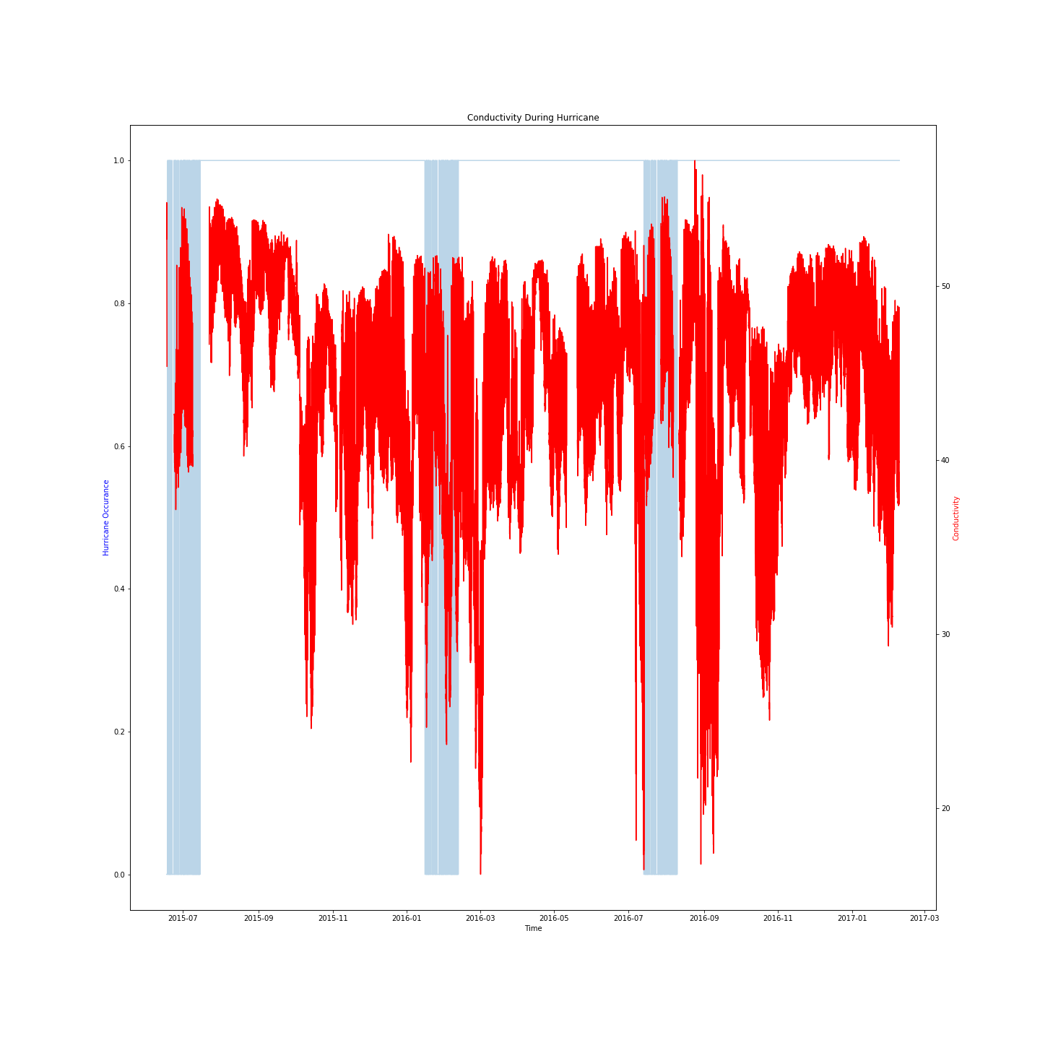
Exploration
Notes:
Another challenge was presented when deciding what information would reveal the most about the project. Graphing the buoy data over hurricane data on a time line may reveal some insights into which features were affected by the weather. Obserservations were made showing how some readings showed clear spikes, while others readings seemed to dive during adverse weather.

Slide 7
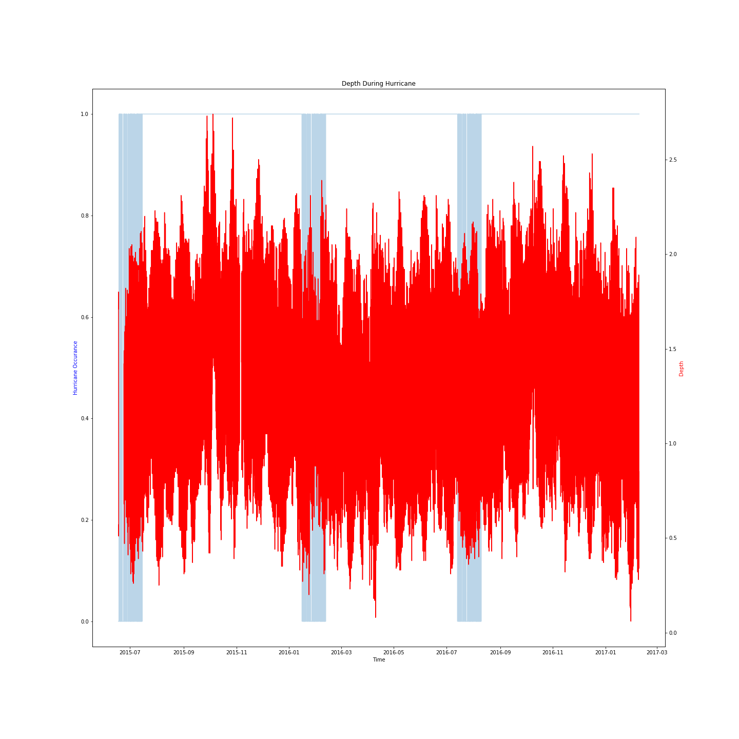
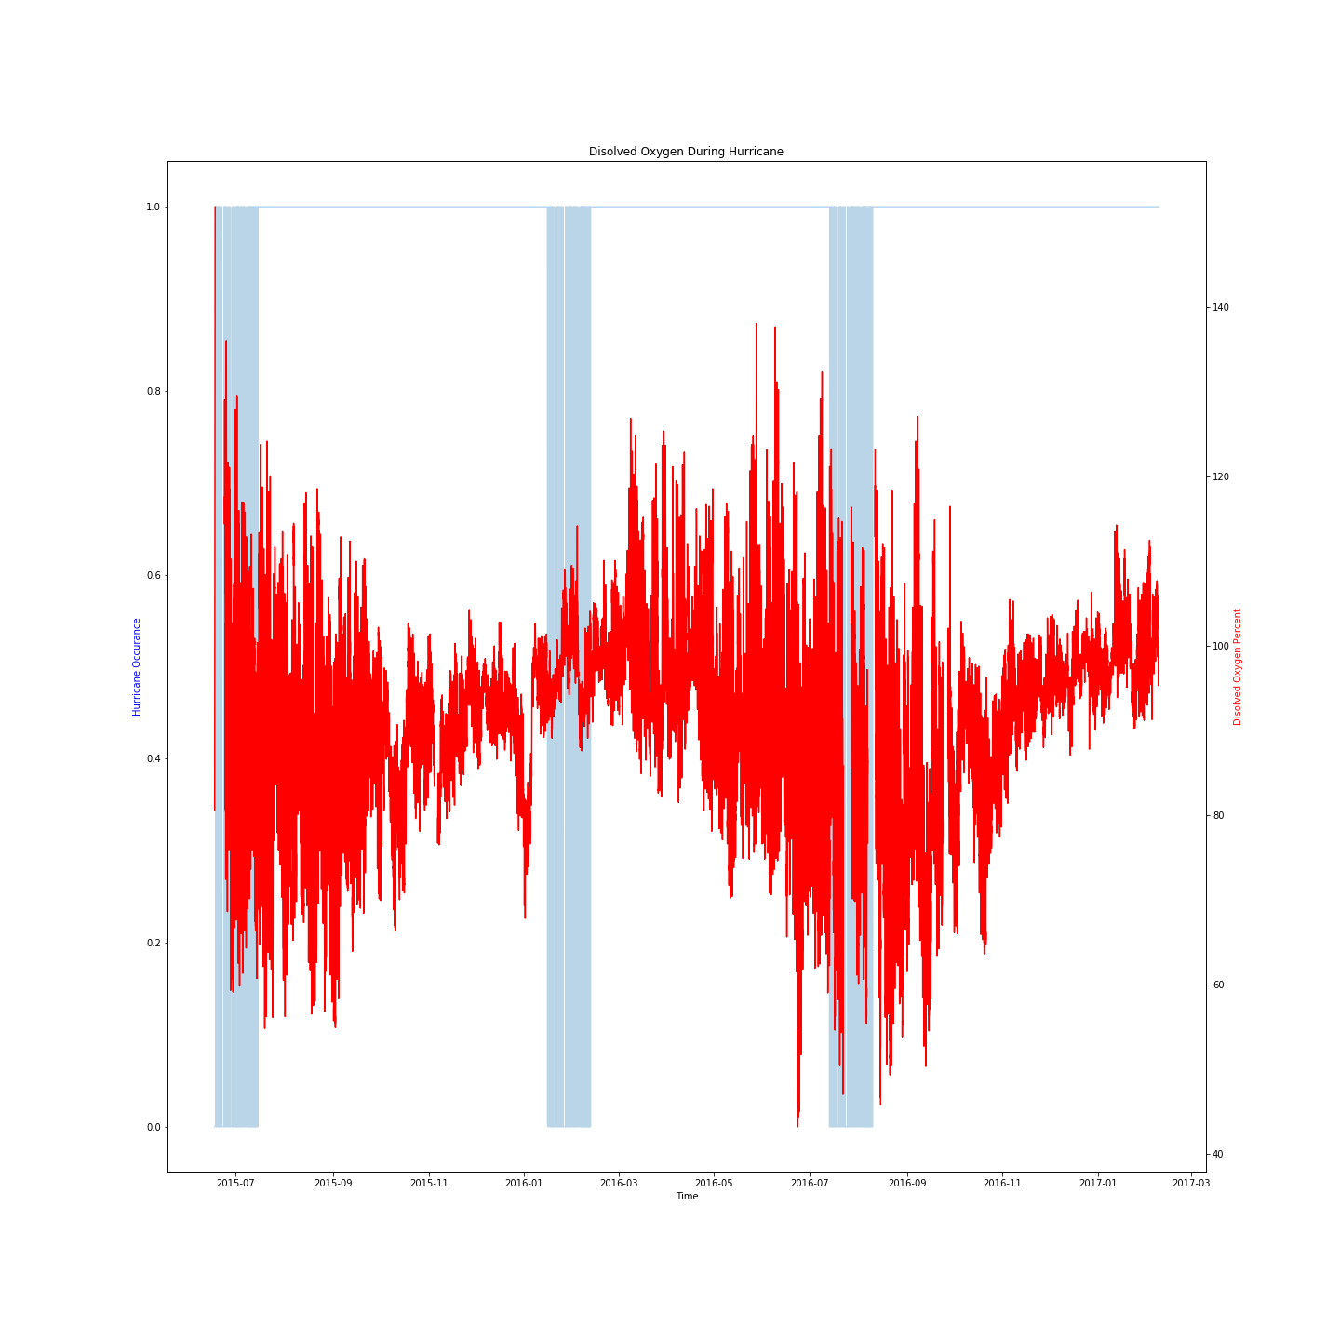
Notes:
But not all of the readings were easy to interpret.

Slide 8
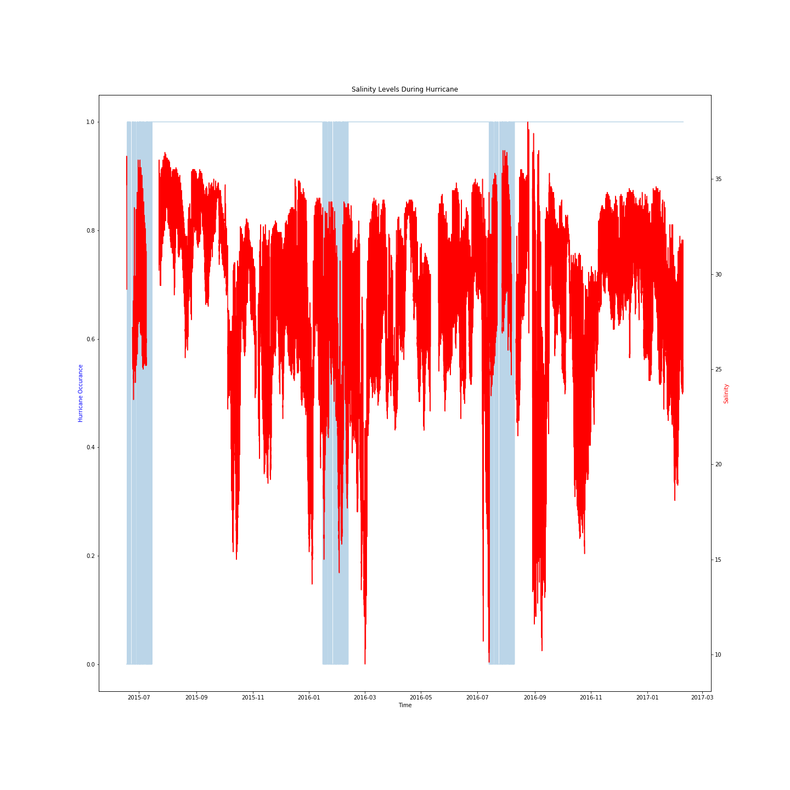
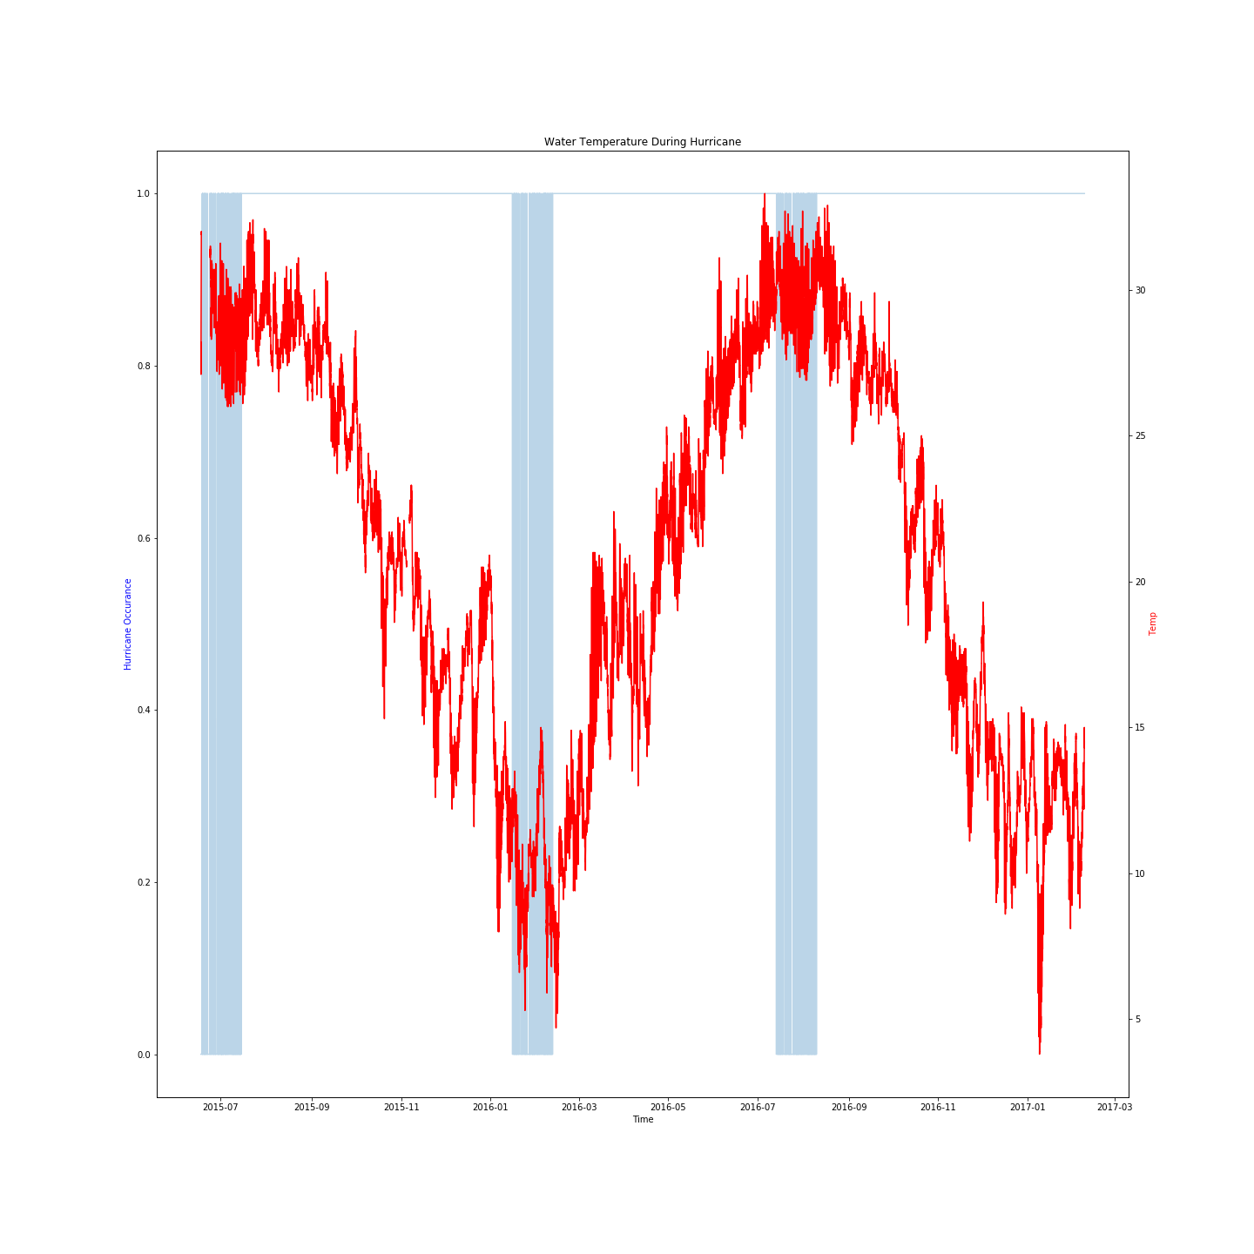
Notes:
During hurricane seasons the water temperature is expected to be relatively warm- but it appears there is an anomaly of some sort in the visual shown here on the right. It is not clear from the available data if this is a buoy failure or an accurate reading.

Slide 9
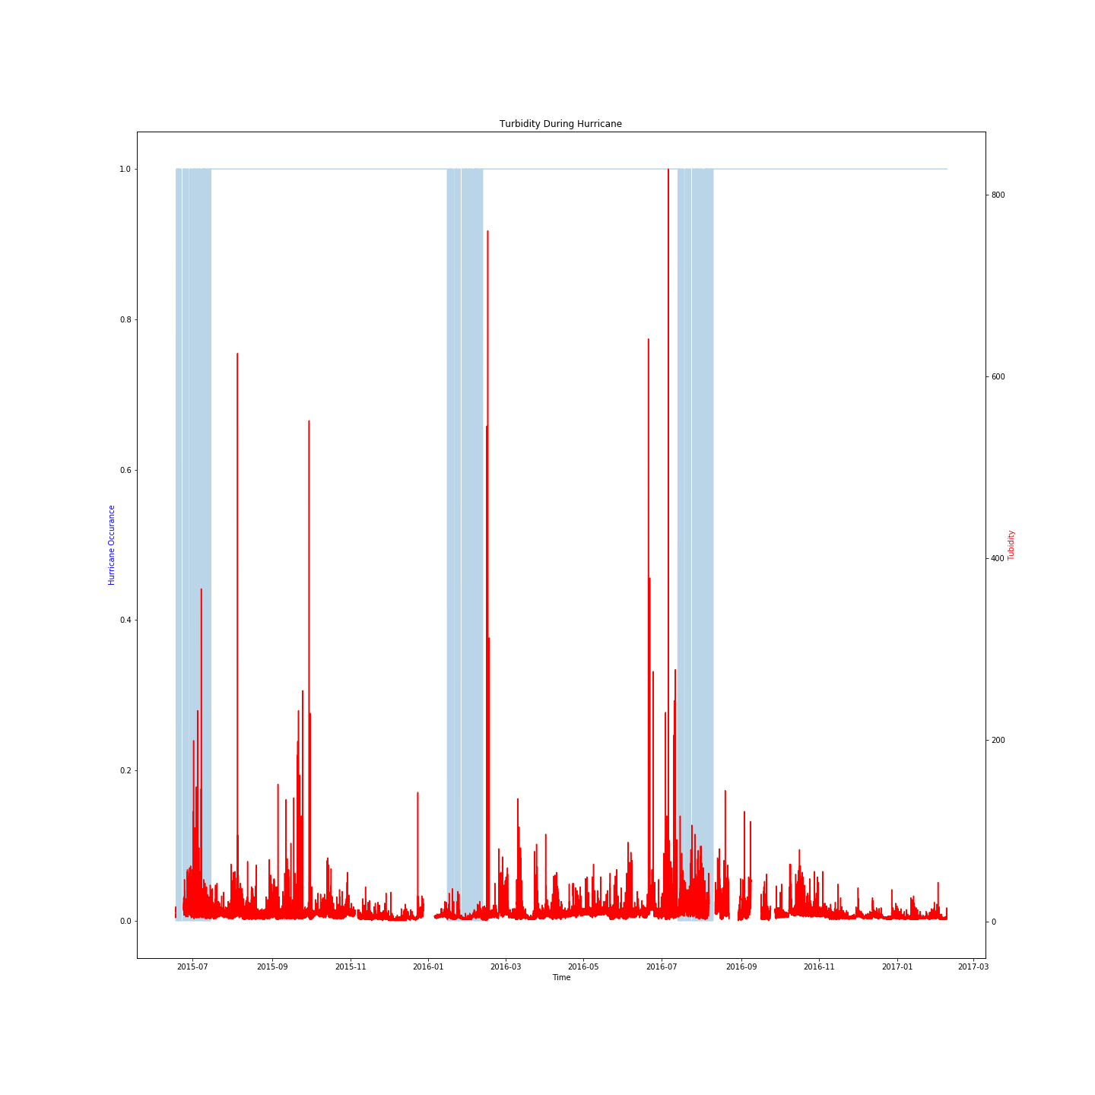
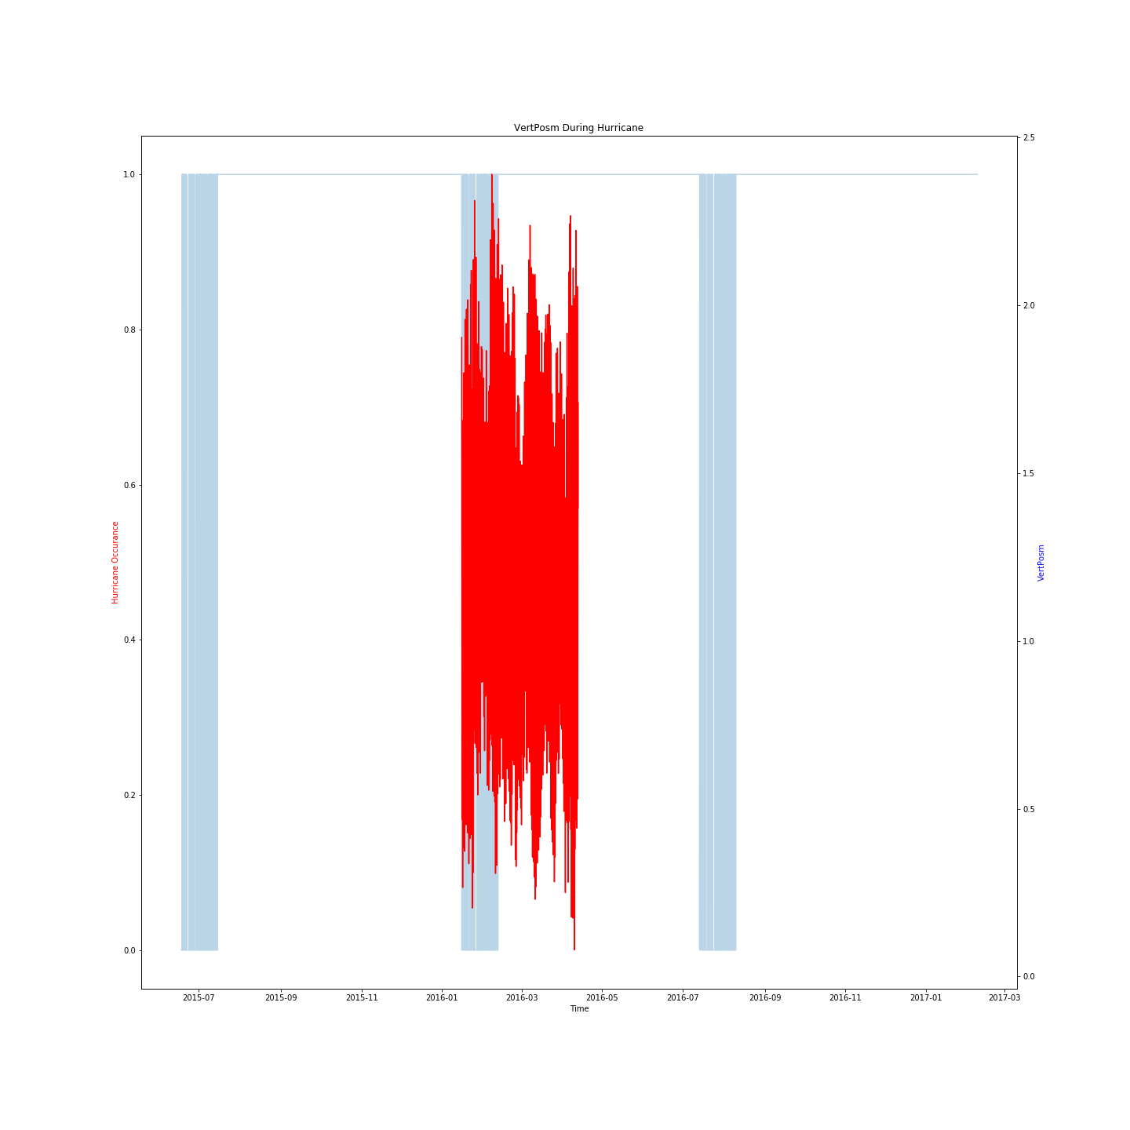
Notes:
After looking at the features for this project, only two of the results appear to lack any sort of meaningful change during hurricane events: VertPosm and water temp. This is due to lack of data and data anomalies.

Slide 10
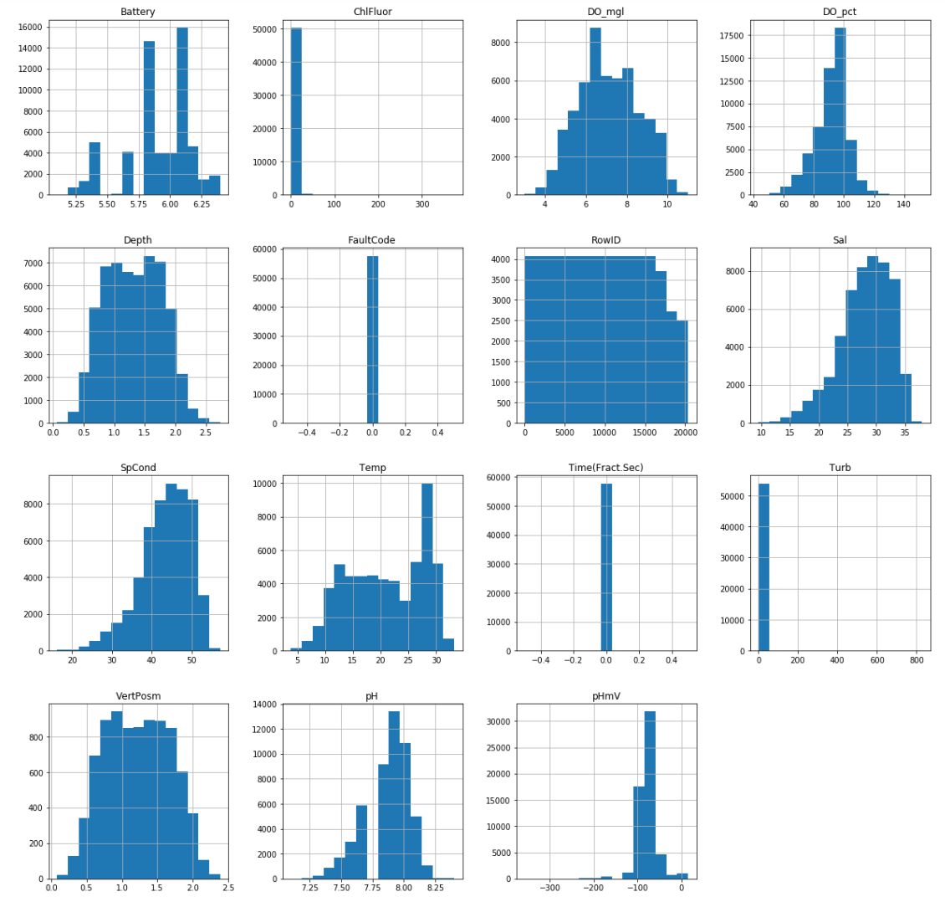
Notes:
Finally a quick look at the data distributions may help decide which models to run the data on as well as identify potential outliers within the data. The data should be scaled before any modelling occurs since each feature uses a different scale of measurement.

Slide 11
Features
Ten Features Dropped due to Sparsity of data
Thirteen remaining features
Battery
ChlFluor
DO_mgl
DO_pct
Depth
Sal
SpCond
Temp
Time
Turb
VertPosm
pH
pHmV
Notes:
Some features in the original data was not produced as a visual due to NANs in several fields. Most of the features that were dropped appeared to be duplicates of existing data, but with slightly different names. The names were identical, but the dropped fields started with f_<name>. A visual inspection of the data determined these fields were not adding any value to the data. Ten columns in all were dropped from the features after this initial exploration. All data was scaled to ensure unit of measurement would not skew results.

Slide 12
Handling NAs
sBest – Drops the worst column (VertPosm) then run dropna() to obtain 42,036
feats_Sparse – runs dropna() on everything to obtain 4,109 entries
featsZeroes – Fills all missing data with zeroes to keep 57,820 entries
feats_filled – Used interpolation to retain 57,820 entries (unusable)
feats_vertZeroes – Filled missing data in VertPosm with zeros before running dropna()
newData – Used the 4,109 entries obtained after dropna() to create synthetic data points by resampling weekly data using the mean and combining results into the dataframe
Running pd.dropna() depleted the data from 57,820 to just 4,109 entries
Notes:
After dropping these columns the goal was to maximise the amount of remaining data to work with. The first thing attempted was running dropna() on the data to find out what was left. The data was so sparse it was uncertain how effectively it could be used to train the models. To overcome this several solutions to the data problem were used and run to see how the models were affected. The worst column for missing data was one labelled VertPosm. A decision to drop this column before running dropna() was made to see how the resulting dataframe would be affected. In doing so there was still enough actual data to be used to model. The sparse data was also tested to see if it would work since it would include vertPosm. It was important to know if this could be a key factor in the data. Additionally, keeping all features in the data, but filling missing values with zeroes was investigated for its effect on modelling. A similar process was used on just vertPosm followed by running dropna on all other features. Finally synthetic data was created to see how creating a dataset as large or small as desired would affect performance. The concern in these approaches centred around losing key features, or diluting the data to an unusable degree. If there were too many filled values around the same time as a weather event then the models may rate readings of 0 as significant predictors.

Slide 13
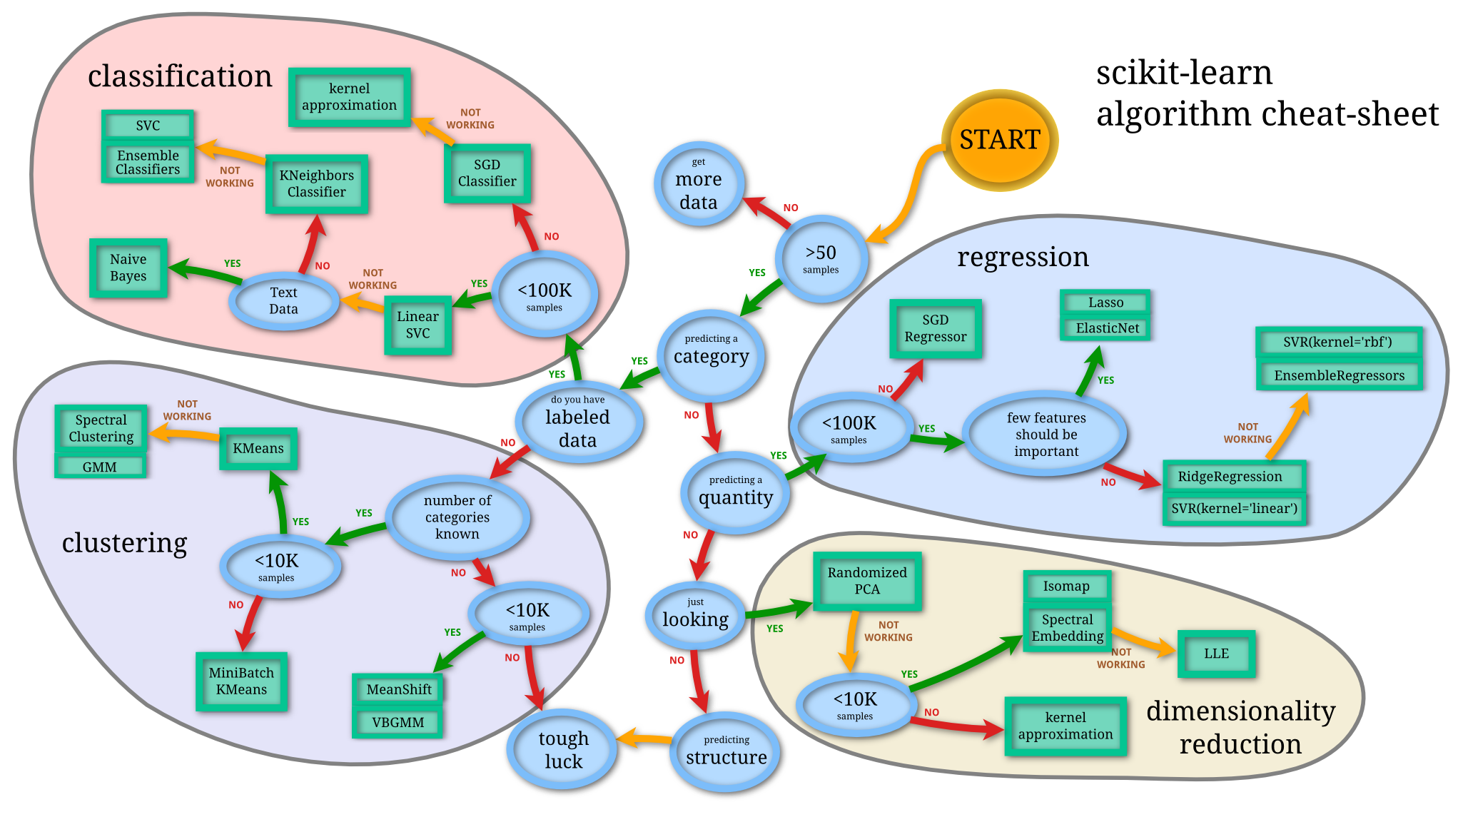
SciKitLearn Flow Chart
A useful starting point
Notes:
To help with addressing all concerns and data sizes, scikit-learn’s helpful flowchart of learning algorithms was used. After following the flow chart the models were researched to decide on which ones would generate the best results. One particular thing about referring to this chart is the helpful guide on data size as a determining factor of informed model selection.

Slide 14
Model Selection
SGDClassifier()
Dense or Sparse arrays for features
Easily scales with data
Efficiency
Ease of implementation
Sensitive to feature scaling
Requires a number of hyperparameters
AdaBoostClassifier()
Fast
Easy
Versitile
Noisy data poses a problem
Sensitive to outliers
GaussianNB()
Simple
Reliable
Needs less training data
Models selected for their ability to handle small data sets and to scale with the data
Notes:
After reading up on the models identified, three models selected to run using GridSearch and a number of parameters. The pros and cons for each one reinforced the decision.

Slide 15
Results
Data
Models
SGD Ada GNB
newData (synthetic)
Sparse
Feats_zeroes
sBest
55% 96% 92%
77% 90% 78%
89% 94% 85%
86% 86% 87%
Notes:
Results determined using skLearn’s accuracy score which is determined as correct_matches/samples. Synthetic data produced the best results using adaboost, however using gaussian naïve bayes gave the best results on my pure dataset. Since a brute force approach to selecting parameters was used, the next step for model improvement would be to improve the data. Access to data dating back to 2000 for buoys is available, however complete measurements are not available for this time window. The data is included in the data folder but more measurements should be located for training.

Slide 16
Principal Component Analysis
pHmV (pH per millivolt) .86
Turb (Turbidity) .85
DO_pct (Disolved Oxygen Percent) .82
ChlFluor (Chlorophyll Fluorescence) .72
SPCond (Conductivity) .71
Five key predictors
Notes:
After running models, scikit-learn’s principal component analysis was used on the sBest data set (which was all real data) to determine what the most important features were. The values for all of the predictors were examined to determine which five values best captured variance within the data. These five predictors account for 95 percent of total data variance.

Slide 17
Future Work
Locate Buoy Data For Southeast Africa
Large number of rogue wave occurrences
Test five principal components as predictors for other hazards
Locate more data spanning a larger time period
Test other models
Notes:
To continue this work additional data should be collected. Data from buoys off the African coast may prove to be particularly useful since confirmed rogue waves have occurred there. The five principal components also deserve a closer look when considering other weather and ocean anomalies. Finally, a larger data set would make other models available for predictions. Some of these models may still outperform the three that were a focus for this work.

